Slide 1
Deciding What Not to Test
Robert Sabourin
President
AmiBug.Com, Inc.
Montreal, Canada
rsabourin@amibug.com

Slide 2

Deciding What Not to Test
Software project schedules are always tight. There is not enough time to complete planned testing. Don't just stop because the clock ran out.
This presentation explores some practical and systematic approaches to organizing and triaging testing ideas. Testing ideas are influenced by risk and importance to your business. Information is coming at your from all angles - how can it be used to prioritize testing and focus on the test with the most value? Triage of testing ideas, assessing credibility and impact estimation can be used to help decide what to do when the going gets tough!
Decide what not to test on purpose - not just because the clock ran out.

Slide 3


Deciding What Not to Test
Robert Sabourin , Software Evangelist
President
AmiBug.Com Inc.
Montreal, Quebec, Canada
rsabourin@amibug.com
www.amibug.com

Slide 4
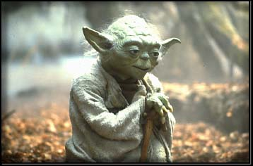
Yoda
Plan to support change
"No! Try not, Do. Or do not.
There is no try."

Slide 5
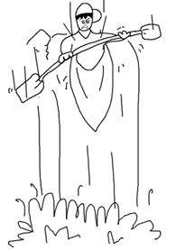
Testing Ideas
Collect all testing ideas you can find!
  List
  Sort
  Organize
  Shuffle
Plan to support change

Slide 6

Testing Ideas
How to find them?
  Does system do what it is suppose to do?
  Does the system do things it is not supposed to?
  How can the system break?
  How does the system react to it’s environment?
  What characteristics must the system have?
  Why have similar systems failed?
  How have previous projects failed?
Plan to support change

Slide 7

Testing Ideas
Collect testing ideas
From testing ideas build a series of testing objectives
  Each can be assigned as work to a tester
  Each can include all, part of, or multiple testing ideas
Capture testing ideas

Slide 8

Testing Ideas
I often use Index Cards
  Unique id
  One testing idea per card
  Colour indicates source
  Shuffled and reviewed
  Organized and reorganized
  Sorted, grouped, prioritized and collected
Capture testing ideas

Slide 9

Testing Ideas
Creative approaches
  Action verbs
  Mind Maps
  Soap Operas
  Lateral Thinking
Capture testing ideas

Slide 10
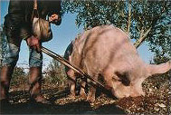
Testing Ideas
Investigative approaches
  We become truffle snorting pigs and try to find useful information in all evidence we discover
  We can even get good ideas from out of date sources
Capture testing ideas

Slide 11
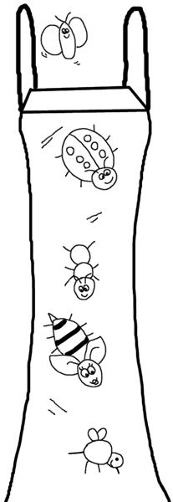
Testing Ideas
Bug taxonomies
  Collections of possible bugs
  Appendix A of Testing Computer Software, Kaner, Falk, Nguyen
  Boris Biezer Taxonomy Otto Vinter manages
  Shopping cart taxonomy Giri Vijayaraghavan
Capture testing ideas

Slide 12

Testing Ideas
Requirements
  Use cases
  Functional requirements
  Quality factors
  Constraints
  Written requirements
  Implicit requirements
Capture testing ideas

Slide 13
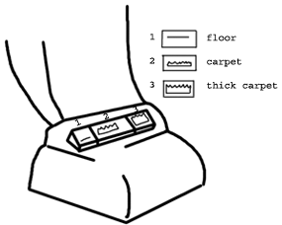
Testing Ideas
Usage Scenarios
  Identify classes of users
  Identify how users will use system
  Describe scenarios
  Use Story board or similar approaches
  Identify variations
Capture testing ideas

Slide 14

Testing Ideas
Functionality Analysis
  Requirements, Design or Prototypes can give insights into
  Domain Analysis
  Equivalence classes
  Boundary analysis
  CRUD
Capture testing ideas

Slide 15
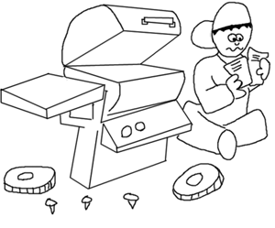
Testing Ideas
Failure Modes
  What can break?
  Reaction to invalid input?
  How does software behave in constrained environment?
    Memory
    Disk Space
    Network Bandwidth
    CPU capacity
    Shared resources
  Stress, Load, Volume
Capture testing ideas

Slide 16
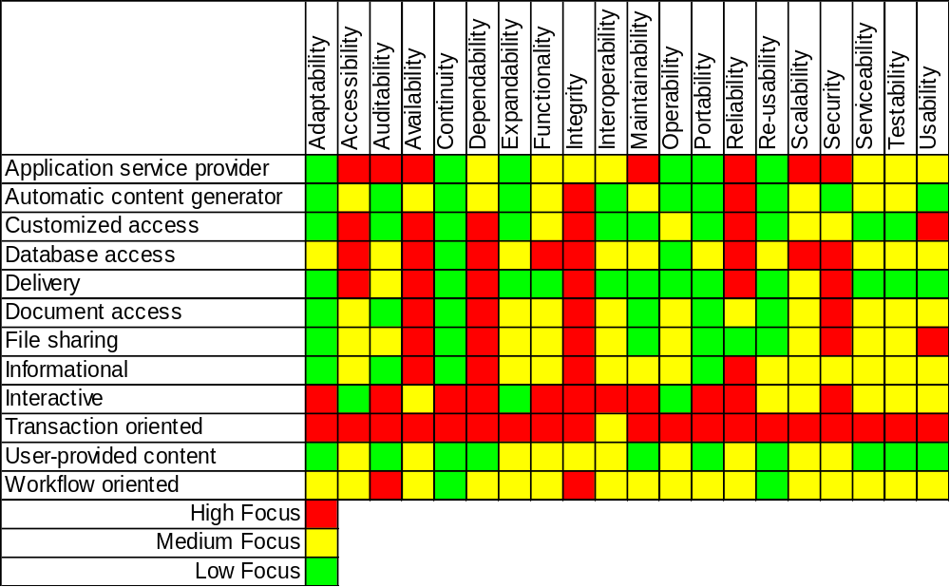
Capture testing ideas
Quality Factors Importance
Different Application Types

Slide 17

Testing Ideas
Oracle Collection
  Strategies to assess correctness
  Similar systems
  Old systems
  Subject matter experts
  GURUs
  Standards
Capture testing ideas

Slide 18
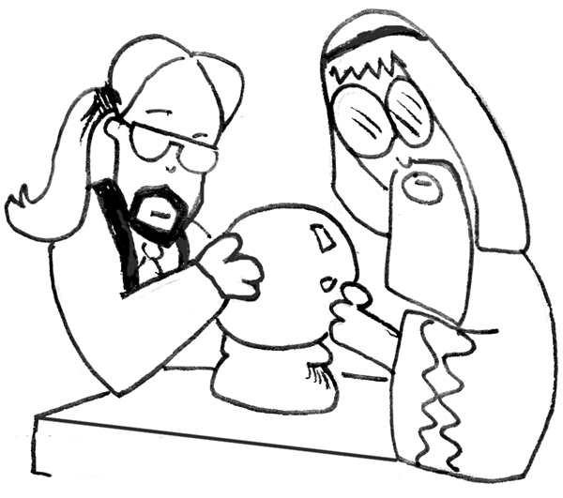
Which test?
Impact estimation
  For each test idea guesstimate:
    benefit of implementation
    consequence of implementation
    benefit for not implementing
    consequence of not implementing
  How credible is the information?
Triage testing ideas

Slide 19
How to Decide?
Understanding Complex Technology Quantitatively By Tom Gilb
Rank | Credibility
0.0 | Wild guess, no credibility
0.1 | We know it has been done somewhere
0.2 | We have one measurement somewhere
0.3 | There are several measurements in the estimated range
0.4 | The measurements are relevant to our case
0.5 | The method of measurement is considered reliable
0.6 | We have used the method in-house
0.7 | We have reliable measurements in-house
0.8 | Reliable in-house measurements correlate to independent external measurements
0.9 | We have used the idea on this project and measured it
1.0 | Perfect credibility, we have rock solid, contract- guaranteed, long-term, credible experience with this idea on this project and, the results are unlikely to disappear
Triage testing ideas

Slide 20
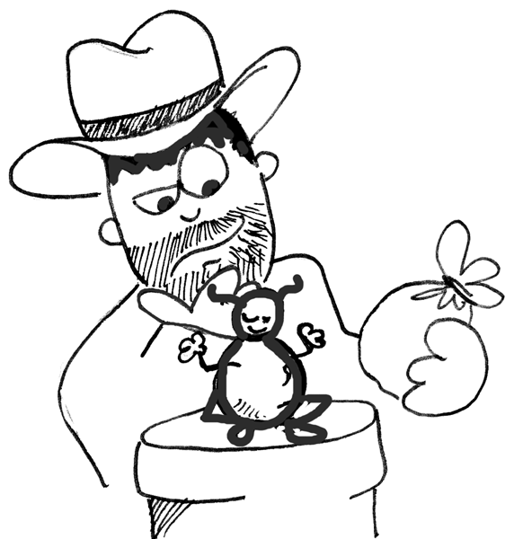
Which test?
Test Idea Rejection – What If?
  If the cost/benefit does not make business sense then consider implementing:
    part of the test, could that lead to part of the benefit at a more reasonable cost?
    more than the stated test, would that generate more benefit?
    a different test than the stated idea, could that generate more benefit for less cost?
Triage testing ideas

Slide 21

Test Triage
Test Triage
  JIT Projects
  High Frequency
  Daily Test Triage Session
  Experience dictates
    Early AM (Rob Preference)
    Late PM (several clients)
Triage testing ideas

Slide 22
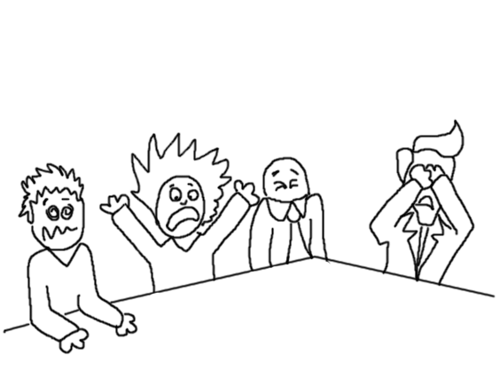
Test Triage
Test Triage Meeting
  Review Context
    Business
    Technical
  Information since last triage
    Test results
    Bug results
    New testing ideas
Triage testing ideas

Slide 23
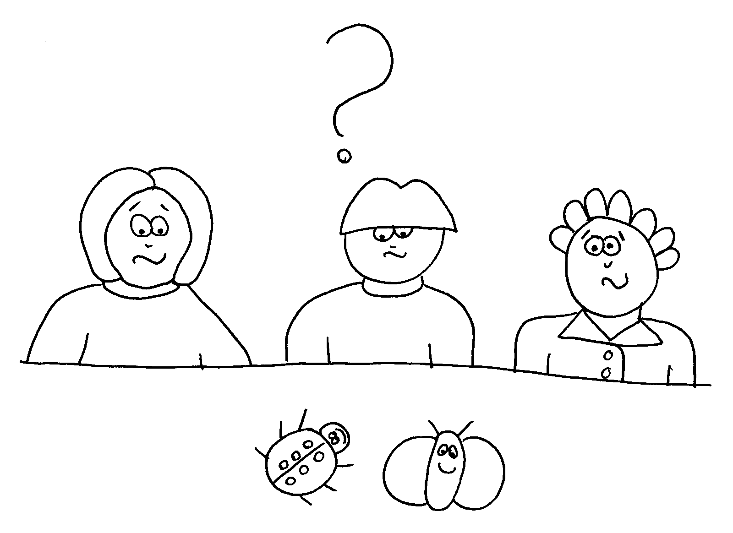
Test Triage
Allocate Testing Assignments to Testers
  Make sure testers know context
  Best thing to test
  Best person to test it
  Best people to explore it
  Best lead
  Are subject matter experts required?
  Blend scripted & exploratory testing
Triage testing ideas

Slide 24
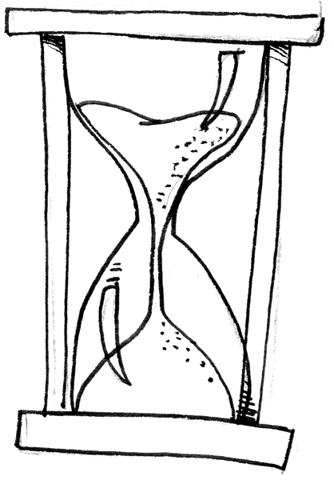
Test Triage
Requirement Triage
Change Control
Test Triage
Bug Flow
  Combined
  Equivalent to CCB
  Few people
  Fluid
Triage testing ideas

Slide 25
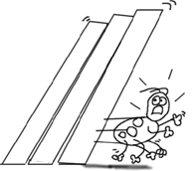
Test Triage
Life of a test idea
  Comes into existence
  Clarified
  Prioritized
    Test Now (before further testing)
    Test before shipping
    Nice to have
    May be of interest in some future release
    Not of interest in current form
    Will never be of interest
  Integrate into a testing objective
Triage testing ideas

Slide 26

Which test is next?
Questions
  Given state of project, state of business, state of technology, our abilities, our experience and our history, what we know and what we do not know, what should we test next?
  How much effort are we willing to spend continuing to test this project?
  Can we ship yet?
Triage testing ideas

Slide 27

Which test is next?
Magic crystal ball
  If it existed how would you use it?
  What question would you ask?
  What question would it ask?
Triage testing ideas

Slide 28
Deciding what not to test?
Time pressure
  Should we skip a test?
  If test failed could system still be of value to some stakeholder?
  If test was skipped could important bugs have been otherwise found?
Triage testing ideas

Slide 29
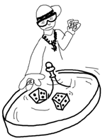
Problem with formulas
Exposure(i) = Risk * Consequence
Allocation(i) = (Exposure(i)/Total Exposure) * MAX
  Units?
  Math?
Triage testing ideas

Slide 30

Guidelines and Decisions
To each stakeholder
  risk of failure
  consequence of failure
  value of success
  how much certainty do we have
  is it a wild guess or an absolute truth?
Get Started Right

Slide 31
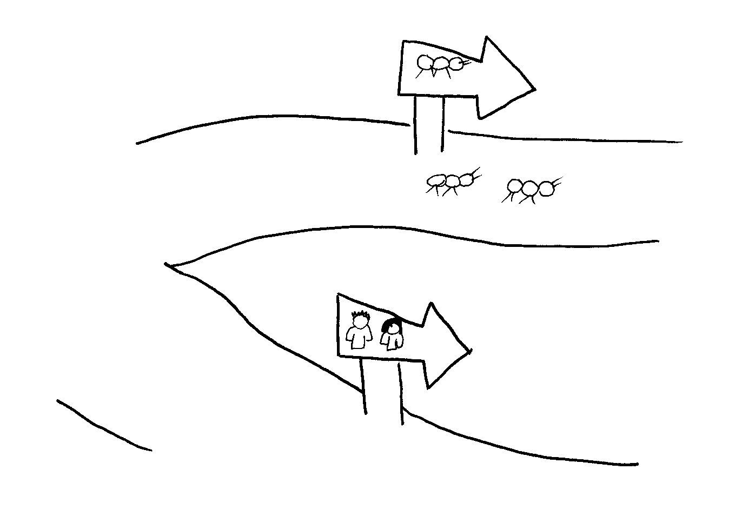

Bottom Line
My experience is that it is better to omit a test on purpose than to skip it because you ran out of time or forgot about it!
Systematically collecting, evaluating and triaging testing ideas helps me decide what not to test - at least for now?
Get Started Right

Slide 32


Thank You
Questions?

